Slide 1

Benign diseases of the ovary and fallopian tube – Part 1 – Content : Physiological / Functional cysts
Dr Sangeetha Menon
Assoc Prof Dept of OBGYN
GMC Kollam

Slide 2
Conditions causing ovarian enlargement :
Benign
Malignant
Borderline malignant lesions

Slide 3
Causes of benign ovarian enlargement :
Functional cysts / cystic ovary
Benign neoplasms / cysts
Infections X
Others : endometrioma, PCOS, OHSS, ovarian ectopic pregnancy,

Slide 4
Cystic ovary vs ovarian cyst
Disturbance of function vs neoplasm

Slide 5
Functional cysts
Follicular cysts
Corpus luteal cysts
Theca lutein cysts

Slide 6
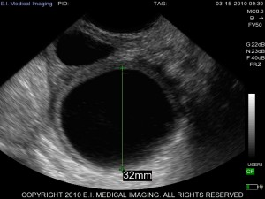
Follicular cysts

Slide 7
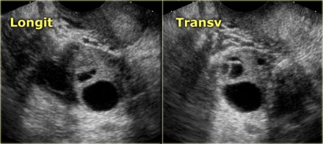

Slide 8
Follicular cysts
Commonest of the functional ovarian cysts
Usually unilateral
3-8 cms , unilocular, clear contents
Usually incidentally discovered - rarely cause pain
Occurs due to non rupture of a follicle - hence lined by granulosa cells
Sometimes seen when there is a short period of amenorrhea followed by bleeding p/v
Can be left alone

Slide 9
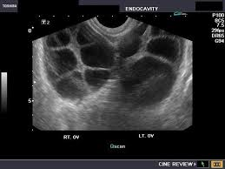
Theca lutein cysts

Slide 10
T-L cysts
Bilateral , multiseptate / multiloculated
Lined by theca cells
Can be seen with pregnancy, multiple pregnancy, molar pregnancy, chorio Ca , OHSS, the trigger being hCG.
Resolves on its own – needs no intervention unless it undergoes torsion, rupture or hemorrhage.

Slide 11
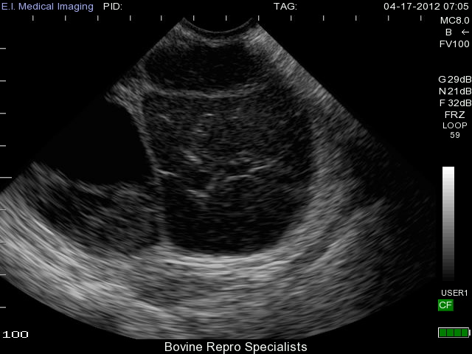
CL cysts

Slide 12
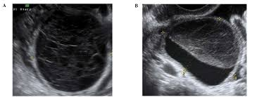

Slide 13
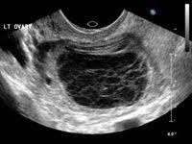

Slide 14
Corpus luteal cysts
After ovulation , the CL forms and may at times become cystic
Seen in early pregnancy
Can be left alone
Rarely can rupture and can cause intra peritoneal hemorrhage necessitating a laparotomy and at times a cystectomy.

Slide 15
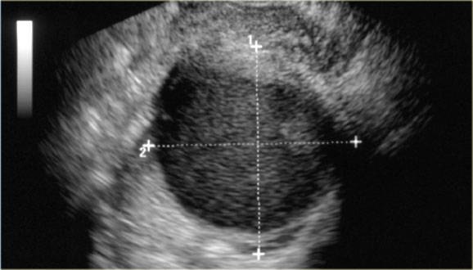
Endometriotic cysts / choclate cysts

Slide 16
Endometriotic cysts
Ca 125 not to be sent !
Small less than 3 cms will do well with medical management
Symptom, size and fertility concerns have to be weighed
COC are good for endometriosis related pain
Progestational agents and GnRH analogues are alternatives
Larger cysts, with ureteral compression/ infiltration, symtomatic will need surgery
Cystectomy preferred over aspiration
Deep infiltrating endometriosis responds to surgery which is difficult !

Slide 17
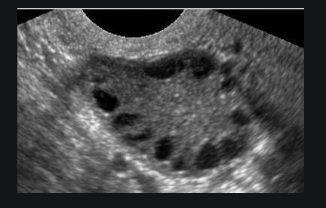

Slide 18
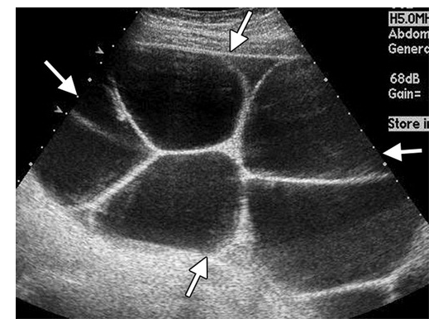

Slide 19
Presentation of functional cysts
Asymptomatic – incidental finding
Lower abdominal distension
Pain lower abdomen – dull ache or can be acute
Menstrual irregularities – amenorrhea- polymenorrhea –

Slide 20
Management of functional cysts
Largely conservative
Will regress over time
Intervention may be needed if enlarging in size, rupture , torsion or hemorrhage.

Slide 21
Ovariotomy = castration !

